Slide 1
Given At: ArchConf2019

Slide 2
Avoiding Lock-In

Slide 3
Previous
Version
Specific
Framework
Custom
Fork
Our own
code

Slide 4
PART I

Slide 5
Stories of the Stupid

Slide 6
git clone https://chromium.googlesource.com/chromium/src

Slide 7
FORK

Slide 8
6.7 million lines of code
150 are yours

Slide 9
0 ☛ Legacy

Slide 10
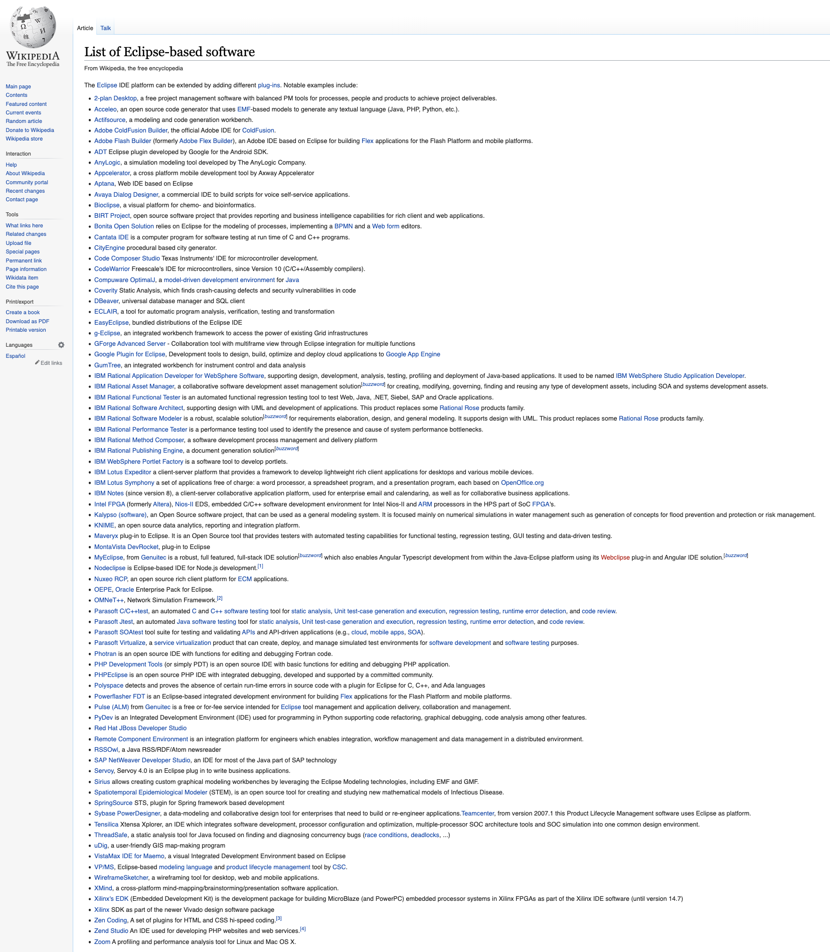


Slide 11
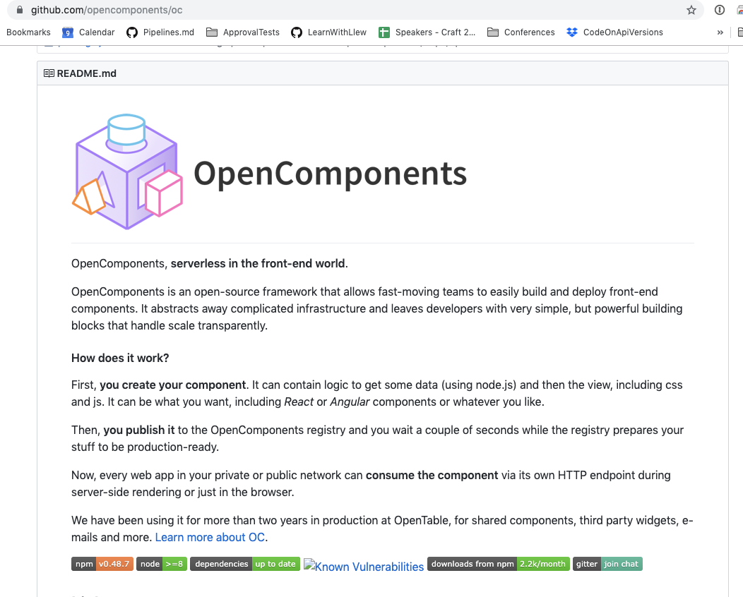
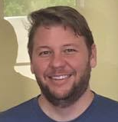

Ken Crawford
Notes:
Open components - aws -> google -> made it extendable -> became a maintainer -> met

Slide 12
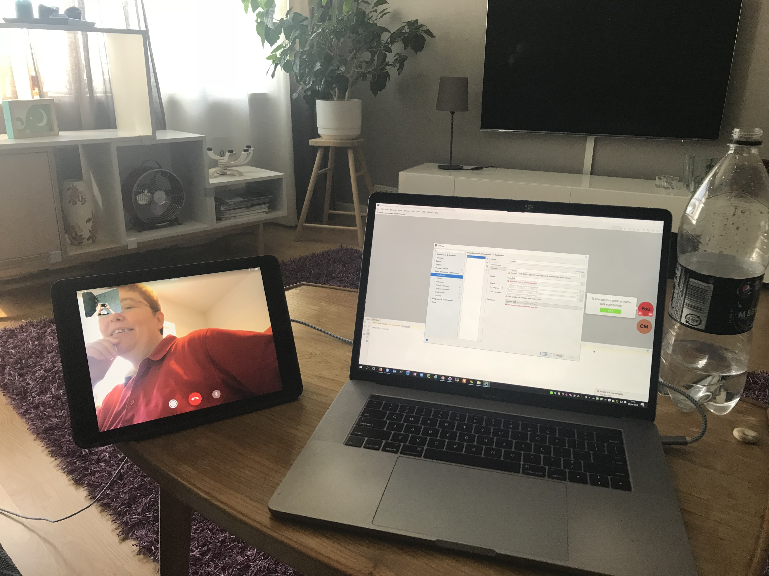
Tips
Pair
https://www.greaterthancode.com/pairing-and-sharing

Slide 13
Tips
Pay

Slide 14
PART II

Slide 15
Framework
Business Logic
Services

Slide 16
Framework
Business Logic
Services

Slide 17
2.
Parameter extraction

Slide 18
2.
Loader & Saver

Slide 19
2.
POJO

Slide 22

Thanks!
Please connect on
LinkedIn & Twitter
@LlewellynFalco
llewellynfalco.blogspot.com
Presentation template by SlidesCarnival

Slide 23
SlidesCarnival icons are editable shapes.
This means that you can:
Resize them without losing quality.
Change line color, width and style.
Isn’t that nice? :)
Examples:

